Slide 1
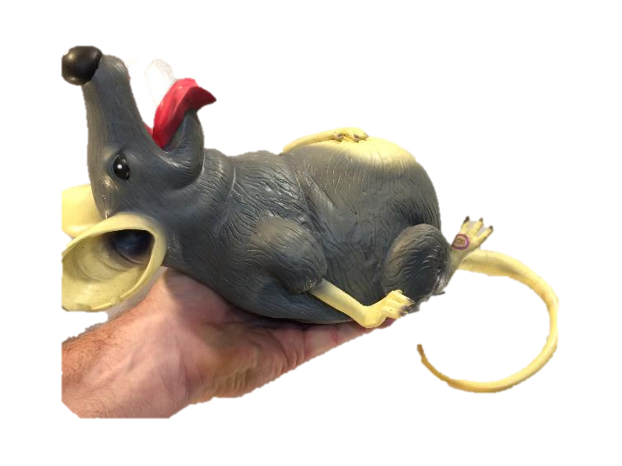
Work and Energy
Potential Energy
Practice Problems
LabRat Scientific
© 2018

Slide 2
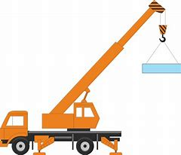
Calculate the gravitational potential energy (relative to the ground) of the load being held by the crane.
Mass of Load = 2,000 kg
4.0 m

Slide 3
Gravitational PE = Mass * Gravity Accel * Height
= 2,000 kg * 9.8 m/sec² * 4.0 m
= 78,400 N*m

Slide 4
If the crane from Problem 1 lowers the load at a constant acceleration of 0.5 G, how much work will the crane do? Is the work positive or negative?
We first must look at the Free Body Diagram to determine the forces involved:
The downward force is: Force = 2,000 kg * 9.8 m/sec2 = 19,600 N
Cable Tension (force being applied by the crane)
Unknown
19,600 N
Weight of the load

Slide 5
Next, we need to use Newton’s 2nd Law to determine the net force needed to create the 0.5 G downward acceleration.
F
F = Ma Rearrange using Algebra a = -------
M
Also, downward acceleration = ½ * 9.8 m/sec² = 4.9 m/sec²
Where “F” is the net external force acting on the load.
Force_{Downward} - Force_{Upward} 19,600 N - Force_{Upward}
4.9 m/sec² = ------------------------------------ = ------------------------------
2,000 kg 2,000 kg
(19,600 N - Force_{Upward}) = 4.9 m/sec² * 2,000 kg
(19,600 N - Force_{Upward}) = 9,800 N

Slide 6
(19,600 N - Force_{Upward}) = 9,800 N
19,600 N - 9,800 N = Force_{Upward}
Force_{Upward} = 9,800 N
Cable Tension (force being applied by the crane)
9,800 N
19,600 N
Weight of the load
This makes sense if we look at the extremes. If the crane cable is cut, the cable tension is zero and the load will freefall at 1 G. If the load is lowered slowly (essentially no acceleration), the cable tension will be equal to the weight of the load. If the crane operator unspools the cable at the right speed, the tension meter on the spool will indicate a reduced tension.

Slide 7
So finally…
The work done by the crane is:
Work = Force * Displacement
= 9,800 N * 4.0 m
= 39,200 N*m
The net work (crane and gravity) done on the load is also 39,200 N*m, but it is positive since the net downward force is acting in the direction of the motion.
Since the upward force being applied by the crane is in a direction opposite the movement of the load, the work is considered negative.

Slide 8
What is the net work done on a 5.0 N bowling ball that is subjected to a 8.0 N upward force and moved upward a distance of 2.5 m?
Since the upward force is greater than the weight of the bowling ball it will move upwards.
The force being exerted by gravity is the weight of the bowling ball. The gravitational work is:
Work_{Gravity} = Weight * Distance
= 5.0 N * 2.5 m
= 12.5 N*m (give this a negative sign)
Work_{Lift} = Force_{Upward} * Distance
= 8.0 N * 2.5 m
= 20.0 N*m
Gravity is working against the motion, so this is negative work.
The bowling ball is moving upwards in and the force is pulling upwards, so this work is positive.

Slide 9
The net work is:
Net Work = Work_{Lift} + Work_{Gravity}
= 20 N*m + (- 12.5 N*m)
= 7.5 N*m

